Slide 2
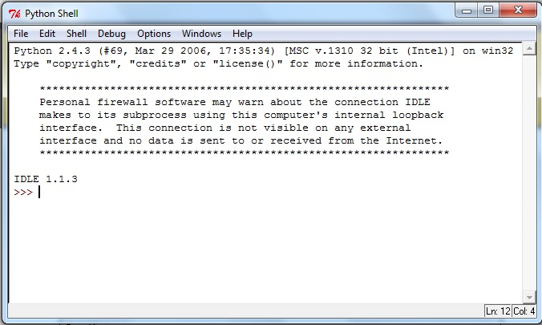
BASIC SYNTAX

Slide 3
Type the following text at the Python prompt and press the Enter:
>>> print "Hello, Python!";
Python version 2.4.3, this produces the following result:
Hello, Python!

Slide 4
Script Mode Programming
Python files have extension .py . Type the following source code in a test.py file:
print "Hello, Python!";
Here is the modified test.py file:
#!/usr/bin/python
print "Hello, Python!";

Slide 5
Python Identifiers
A Python identifier is a name used to identify a variable, function, class, module, or other object. An identifier starts with a letter A to Z or a to z, or an underscore (_) followed by zero or more letters, underscores and digits (0 to 9).
Python does not allow punctuation characters such as @, $, and % within identifiers.
Class names start with an uppercase letter. All other identifiers start with a lowercase letter.
Starting an identifier with a single leading underscore indicates that the identifier is private.
Starting an identifier with two leading underscores indicates a strongly private identifier.

Slide 6
Python Keywords
And | exec | Not
Assert | finally | or
Break | for | pass
Class | from | print
Continue | global | raise
def | if | return
del | import | try
elif | in | while
else | is | with
except | lambda | yield

Slide 7
Quotation in Python
Python accepts single ('), double (") and triple (''' or """) quotes to denote string literals, as long as the same type of quote starts and ends the string.
word = 'word'
sentence = "This is a sentence."
paragraph = """This is a paragraph. It is made up of multiple lines and sentences."""

Slide 8
Comments in Python
A hash sign (#) that is not inside a string literal begins a comment.
Code
#!/usr/bin/python
# First comment
print "Hello, Python!"; # second comment

Slide 9
VARIABLE TYPES
Variables are nothing but reserved memory locations to store values.
Based on the data type of a variable, the interpreter allocates memory and decides what can be stored in the reserved memory.
Assigning Values to Variables
The equal sign (=) is used to assign values to variables.
Program:
#!/usr/bin/python
counter = 100 # An integer assignment
miles = 1000.0 # A floating point
name = "John" # A string
print counter
print miles
print name

Slide 10
Python Strings
Strings in Python are identified as a contiguous set of characters represented in the quotation marks.
Program:
#!/usr/bin/python
str = 'Hello World!'
print str # Prints complete string
print str[0] # Prints first character of the string
print str[2:5] # Prints characters starting from 3rd to 5th
print str[2:] # Prints string starting from 3rd character
print str * 2 # Prints string two times
print str + "TEST" # Prints concatenated string

Slide 11
Python Lists
list contains items separated by commas and enclosed within square brackets ([]).
The values stored in a list can be accessed using the slice operator ([ ] and [:]) with indexes starting at 0 in the beginning of the list and working their way to end -1.
Program:
#!/usr/bin/python
list = [ 'abcd', 786 , 2.23, 'john', 70.2 ]
tinylist = [123, 'john']
print list # Prints complete list
print list[0] # Prints first element of the list
print list[1:3] # Prints elements starting from 2nd till 3rd
print list[2:] # Prints elements starting from 3rd element
print tinylist * 2 # Prints list two times
print list + tinylist # Prints concatenated lists

Slide 12
Python Tuples
A tuple is another sequence data type that is similar to the list.
A tuple consists of a number of values separated by commas.
Main differences between lists and tuples are: Lists are enclosed in brackets ( [ ] )
Program:
#!/usr/bin/python
tuple = ( 'abcd', 786 , 2.23, 'john', 70.2 )
tinytuple = (123, 'john')
print tuple # Prints complete list
print tuple[0] # Prints first element of the list
print tuple[1:3] # Prints elements starting from 2nd till 3rd
print tuple[2:] # Prints elements starting from 3rd element
print tinytuple * 2 # Prints list two times
print tuple + tinytuple # Prints concatenated lists

